Slide 1



A Presentation On
FIX IT - Website Project for Students
Prepared By:
Anuj Modi[21CE072]
Dhruv Nasit[21CE079]
Om Nai[21CE081]
Kalp Pandya[21CE084]
Guided By: Prof. Ashvin Makwana
Prof. Arpita Shah

Slide 2

Introduction
Fix it is a Website project for solving college students Problems regarding any technical or non-technical problems.
Student can state their problems and can register complaint through our platform.
Our project will make sure that students problem should be solved and hence will also make sure that resources get utilized efficiently.
Our project will also focus on problems faced by students who resides in campus thus solving difficulties by registering complaint .
It also make sure that admin side get correct information thus allow them to access to the right concern.

Slide 3

Why do we developed this project?
As a technical students we face a lot of difficulties while accessing tech machines like pcs, projector and other machines which are not properly functioning.
So, basically we can’t use them. So to make that machine a useful resource we have developed a project through which a user(Student) can describe the concern and that will be reached to the right person.
It has been also kept in mind that the admin person gets the right information and he/she should be addressed properly, thus making them clear where the problem is.

Slide 4


SCOPE:
This project is easy to use.
The complaint registration is made easy so that any student should not face any problem while using it.
This project is also be designed in such a way that even admin portal can detect easily where should they work.
This project is very reliable.
This project is useful for both students and technicians and admin portal.

Slide 5

Technical Specification
IDE - Visual Studio Code
Frontend - HTML,CSS, Bootstrap
Backend – PHP
Database – PHP-MYSQL
UI Designing - Figma

Slide 6



User Modules (user-side)
Register complaint
Log in
Feed-Back

Slide 7
User Modules (Admin-side)
Log in
List of Complaint

Slide 8

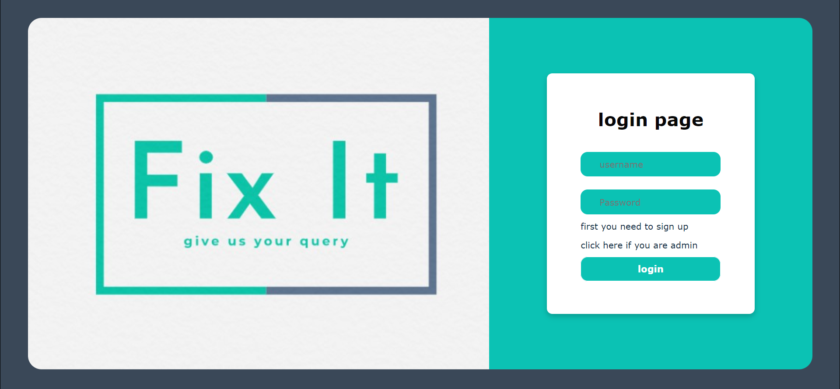
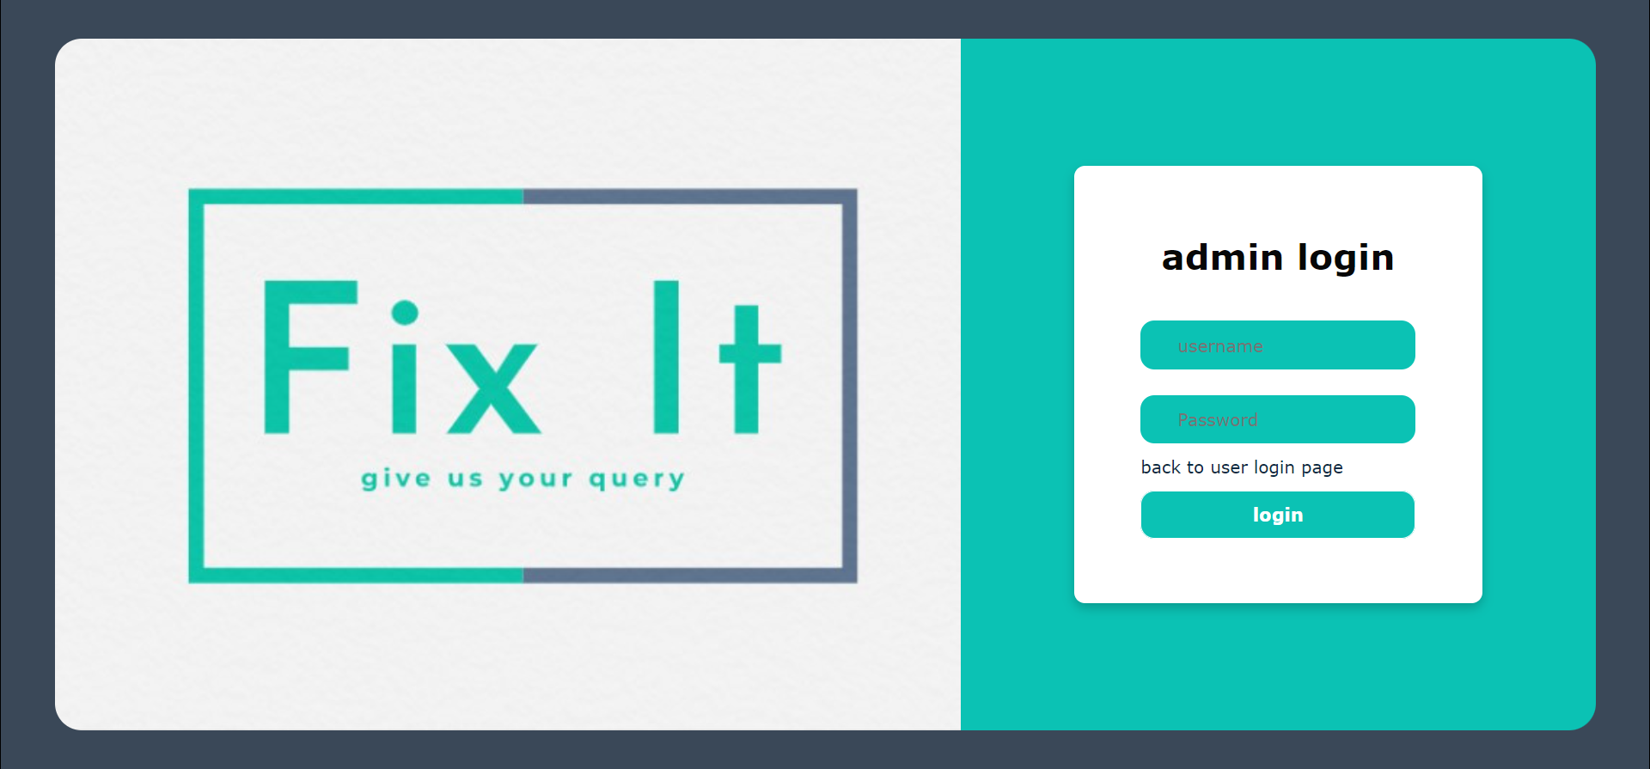
GUI
Login Page
Admin Page

Slide 9
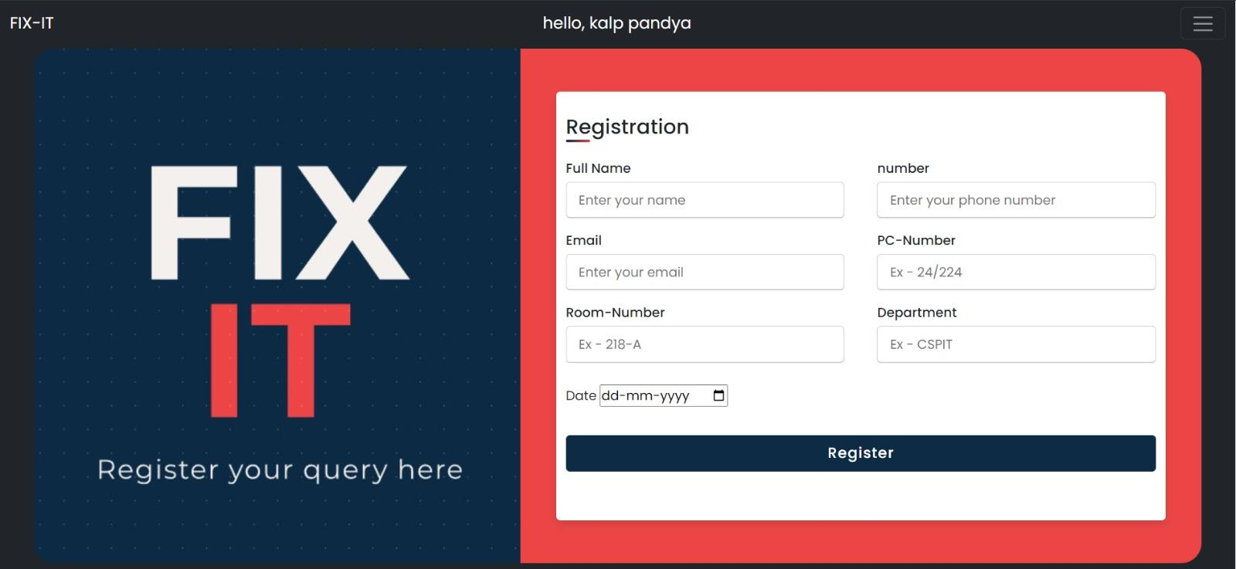

GUI
Registration Form
Successful Registration

Slide 10
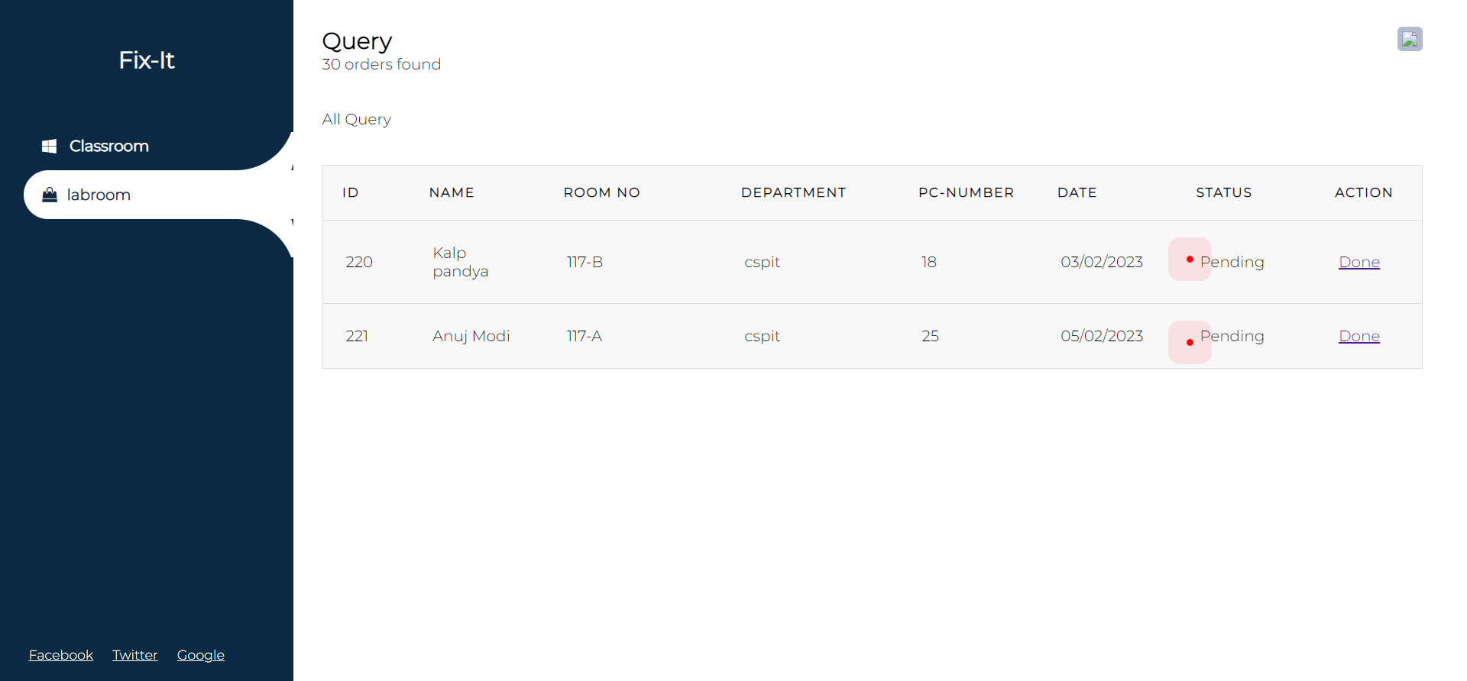
GUI
Complain Portal

Slide 11
Functionalities
Log-in
User or Admin have to login to register or to view complaints respectively.
Once they have to sign up then they can login

Slide 12
Functionalities
Complain Register
Once the user login, they have to register the complaint by filling the correct information and details.
Students can register complaints like pc not working or girls students can register complaint which they face in their hostels like ac not working, geyser not working etc.

Slide 13

Functionalities
List of Complain
Once the admin login, they can see registered complaint by students and can get the details.
Admins will get the information like lab-no , pc-no and the detailed information about the problem.

Slide 14
Functionalities
Feed Back
Users can give the feedback of their experience and they can also suggest some suggestions.

Slide 15
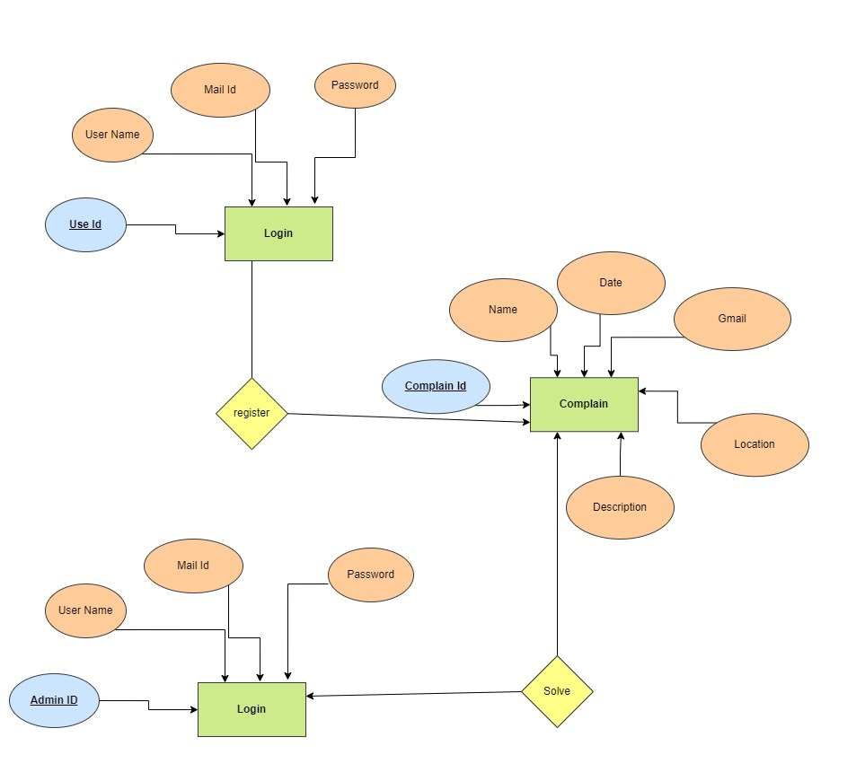
E R Diagram

Slide 16
GitHub Repository Link
https://github.com/om51203/SGP_SEM4

Slide 17
SRS Documentation
SRS Documentation

Slide 18
Excel Sheet And Work Diary
https://docs.google.com/spreadsheets/d/1lpfpmSR9NhXBlOLEnpVdhjT-raMoPCiA/edit?usp=sharing&ouid=117237078837507988950&rtpof=true&sd=true

Slide 19

THANK YOU

